Slide 1
Young Adult Premium Subsidy Proposed Parameters
Johanna Fabian-Marks, Director of Policy & Plan Management
Maryland Health Benefit Exchange
April 19, 2021

Slide 2
Agenda
Background
Proposed Program Parameters
Next Steps

Slide 3
Background
HB 780/SB 729 (2021), which establish a young adult subsidy pilot program, passed the legislature. If the Governor takes no action, they will become law on June 1.
This legislation grew out of work done throughout 2020.
In accordance with HB 196/SB 124 (2020), MHBE submitted a report to the legislature evaluating a state-based individual market health insurance subsidy on Dec. 1, 2020. To inform the report:
MHBE worked with Lewis & Ellis, in consultation with the MIA, to complete an actuarial analysis, which was published for public comment from Oct. 2-Nov. 2, 2020.
MHBE formed a stakeholder work group that met in fall 2020 and produced a report of recommendations.

Slide 4
HB 780/SB 729 – Maryland Health Benefit Exchange – State-Based Young Adult Health Insurance Subsidies Pilot Program
Directs MHBE, in consultation with the Insurance Commissioner and as approved by the Board, to establish eligibility and payment parameters for the pilot program in 2022 and 2023
MHBE shall consider young adults 18-40, between 133% and 400% FPL
Directs MHBE to adopt implementing regulations by Jan. 1, 2022
Subject to available funds, in FY 22-24 MHBE may designate reinsurance funds to be used for the program so that not more than $20M in annual subsidies may be provided in CY 22 and 23

Slide 5
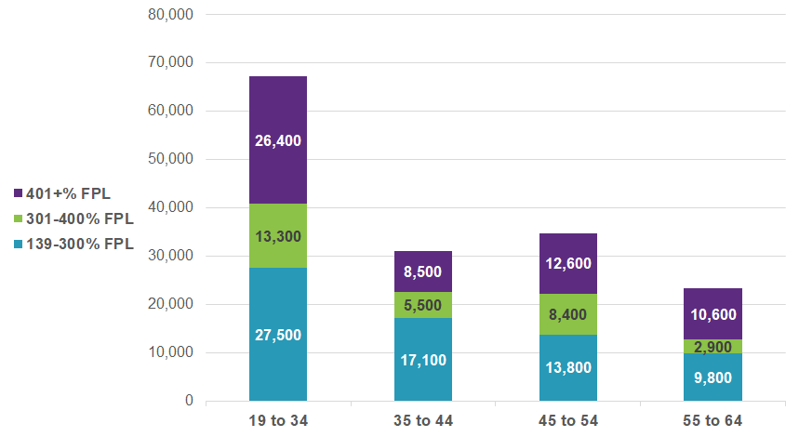
Uninsured Maryland Adults by Age and Federal Poverty Level
Distribution of uninsured Maryland adults with incomes too high for expanded Medicaid coverage, limited to lawfully present residents, by age and income as a percentage of FPL: 2018
Young adults are the largest group of uninsured (67,200; 43% of adult uninsured). A majority are below 400% FPL.
Source: Analysis by Families USA National Center for Coverage Innovation of 2018 data from the American Community Survey. IPUMS USA, University of Minnesota, www.ipums.org. Note: ACS data do not include immigration status. These estimates impute immigration status based generally on previous Urban Institute results.

Slide 6
Proposed 2022 Young Adult Subsidy Program Parameters
Eligibility
Age: 18-34 (18 or older; younger than 35)
Income: 138% to 400% FPL
Eligible to enroll through MHC
Enrolled through MHC
Enrollment cap if projections indicate that budget may be exceeded
Subsidy Design
Reduce the maximum expected contribution by 2.5% between ages 18 and 30
For ages 31 to 35, reduce the 2.5% reduction by 0.5% each year
Projected 2022 cost: $17M
Expected Contribution (EC) for Benchmark Plan
% FPL | Federal EC | Proposed MD Young Adult EC
 |  | 18-30 | 31 | 32 | 33 | 34 | 35
 |  | -2.5% | -2.0% | -1.5% | -1.0% | -0.5% | -0.0%
≤150 | 0.00% | 0.00% | 0.00% | 0.00% | 0.00% | 0.00% | 0.00%
200 | 2.00% | 0.00% | 0.00% | 0.50% | 1.00% | 1.50% | 2.00%
250 | 4.00% | 1.50% | 2.00% | 2.50% | 3.00% | 3.50% | 4.00%
300 | 6.00% | 3.50% | 4.00% | 4.50% | 5.00% | 5.50% | 6.00%
400 | 8.50% | 6.00% | 6.50% | 7.00% | 7.50% | 8.00% | 8.50%

Slide 7
Proposed MD Young Adult Subsidy Expected Contribution Levels by FPL, Compared to Federal Levels

Slide 8
Young Adult Subsidy Example: 28-year-old in Baltimore City
Benchmark Plan Monthly Premium After APTC
Benchmark Plan Monthly Premium After APTC + State Subsidy

Slide 9
Other Subsidy Structures Considered
Maximum Applicable Percentage by Subsidy and Age at 200% of the FPL
This graph illustrates the impact of each subsidy by age.
The graph focuses on an individual at 200% of the FPL – these lines will vary at other income levels.
For higher incomes (e.g., 300% of FPL), AASE becomes the richest subsidy structure.

Slide 10
Next Steps
April 19: Board votes on proposed 2022 parameters
April 19-30: Public comment period
May 17: Board votes on final 2022 parameters

Slide 11
Motion
I move to [approve/defer/reject] the proposed young adult premium subsidy parameters for plan year 2022 [as presented] or [as amended].

Slide 12
Appendix

Slide 13
Reinsurance Update
Our last actuarial analysis in July 2020 estimated federal funding would exceed program cost for all years of the waiver
Recent data challenges some assumptions in the July 2020 analysis
Lower federal funding for 2021: CMS estimate for 2021 is 25% below 2020 level
Federal funding may increase if recalculated to account for American Rescue Plan Act
Slightly higher cost for 2020: Recent CMS estimates lead us to estimate 2020 costs will be ~7% above projection
Legislative draws on reinsurance funding
FY22 budget transfers $100M in state funds from the reinsurance fund in FY 21 and FY 22
SB 172 would transfer $15M in state funds from the reinsurance fund in each of FY 23-25

Slide 14
Actual & Projected SRP Fund Expenses and Income
 | 2019 Act. | 2020 Est. | 2021 Est. | 2022 Est. | 2023 Est.
SRP Cost | $352,798,597 | Orig: $377,828,828 New: 405,000,000 | Orig: $416,782,404 New: 445,500,000 | Orig: $447,975,589 New: 490,000,000 | Orig: $478,434,269 New: $539,000,000
Budget Transfer |  |  | $100,000,000 | $100,000,000
YA Subsidy |  |  |  | $20,000,000 | $20,000,000
Health Equity |  |  |  |  | $15,000,000
Fed. Funding | $373,395,635 | $447,277,359 | Orig: $567,748,703 New: $335,383,207 | Orig: $628,614,048 New: $335,000,000 | Orig: $684,842,457 New: $358,000,000
State Funding | $326,889,258 | $118,517,416 | $112,591,545 | $118,896,671 | $125,554,885
End of Year Balance – Fed. | $20,249,819 | $62,874,397 | $0 | $0 | $0
End of Year Balance - State | $326,889,258 | $445,406,674 | $410,755,823 | $254,602,494 | $164,552,379

Slide 15
Actual & Projected SRP Fund Expenses and Income - Caveats
Numbers presented in previous chart are high-level estimates
Federal funding for 2021 may be higher than shown if CMS incorporates the effect of the American Rescue Plan Act
Lewis & Ellis will be doing a detailed update of reinsurance projections between now and July

Slide 16
Projected Impact of Proposed Subsidy*
2021 % enrolled of eligible | 2023 % enrolled of eligible | 2023 Increase in Enrollment | 2023 Gross Premium PCPY | 2023 Net Premium PCPY | 2023 State Subsidy PCPY
41% | 64% | 21,800 | $4,587 | $713 | $537
2022 YA Subsidy Cost | 2023 YA Subsidy Cost | 2022 Change in Morbidity – Impact to Premiums (all) | % Subsidy Recipients who are New Enrollees by 2023 | 2023 Cost per New Member
$17.0M | $19.4M | -4.6% | 49% | $888
*Assumes ARPA APTC levels are continued in 2023

Slide 17
Other Subsidy Structures Considered - Impacts
Advantages of the proposed subsidy compared to other subsidy structures that were modeled
Most efficient as measured by cost per new member
Increase in enrollment and impact to premiums comparable to more costly structures
Design targets aid to lower-income young adults
Within budget
Simple formula
0 |  | A | B | C | D | E | F | G | H | I | J | K
Scenario | Age | 2021 % enrolled of eligible | 2023 % enrolled of eligible | 2023 Increase in Enrollment | 2023 Gross Premium PCPY | 2023 Net Premium PCPY | 2023 State Subsidy PCPY | 2022 YA Subsidy Cost | 2023 YA Subsidy Cost | 2022 Change in Morbidity – Impact to Premiums (all) | % Subsidy Recipients who are New Enrollees by 2023 | 2023 Cost per New Member
Reinsurance | 18-34 | 41% | 41% | - | $4,782 | $1,035 | $0 | - | - | - | - | -
Subsidies for Young Adults under 400% FPL
AASE | 18-34 | 41% | 67% | 24,400 | $4,584 | $486 | $857 | $27.4M | $32.0M | -5.0% | 53% | $1,312
Proposed Subsidy | 18-34 |  | 64% | 21,800 | $4,587 | $713 | $537 | $17.0M | $19.4M | -4.6% | 49% | $888
AASE 34 | 18-34 |  | 45% | 3,300 | $4,820 | $948 | $131 | $3.1M | $3.3M | -0.8% | 11% | $997
Variation of original AASE with no cliff (LI = linear interpolation)
AASE 30; LI to 35 | 18-34 | 41% | 66% | 23,400 | $4,598 | $594 | $732 | $23.1M | $26.9M | -4.9% | 51% | $1,148
AASE; LI to 40 | 18-39 | Not modeled – was most expensive YA subsidy in original modelling and would be more expensive than AASE | 58% | 20,900 | $5,255 | $1,244 | $1,326 | $64M | $12M | -3.5% | 30% | $3,066
Variation between the original AASE and AYEA (LI = linear interpolation)
AASE +1%; LI to 35 | 18-34 | 41% | 57% | 15,000 | $4,714 | $887 | $532 | $14.5M | $16.9M | -3.1% | 39% | $1,122
AYEA -3.5% | 18-34 | 41% | 66% | 23,600 | $4,582 | $561 | $719 | $23.2M | $26.5M | -4.8% | 52% | $1,126

Slide 18
Young Adult Subsidy Structures Detailed (1/2)
Maximum Applicable Percentage by Subsidy and Age at various FPL
The graphs above illustrate the income cap (maximum applicable percentage) for three scenarios at various FPLs: 1) APTC (federal APTC under ARPA), 2) AYEA, and 3) AASE+1% with linear interpolation to 35. The distance between a Young Adult scenario and the APTC scenario is the state subsidy.
AYEA is richer for lower income groups (and results in a free plan for those at or below ~212% FPL), while AASE+1%, LI to 35 is richer for higher income groups.

Slide 19
Young Adult Subsidy Structures Detailed (2/2)
Maximum Applicable Percentage by Subsidy and Age at various FPL
Note: y-axis scale is different between previous slide and current slide
The graphs above illustrate the income cap (maximum applicable percentage) for three scenarios at various FPLs: 1) APTC (federal APTC under ARPA), 2) AYEA, and 3) AASE+1% with linear interpolation to 35. The distance between a Young Adult scenario and the APTC scenario is the state subsidy.
AYEA is richer for lower income groups (and results in a free plan for those at or below ~212% FPL), while AASE+1%, LI to 35 is richer for higher income groups.

Slide 20
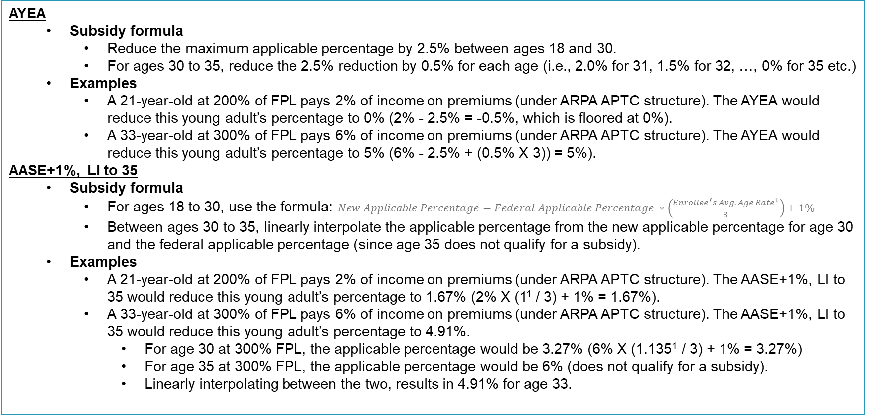
Young Adult Subsidy Structures Formulas
AYEA
Subsidy formula
Reduce the maximum applicable percentage by 2.5% between ages 18 and 30.
For ages 30 to 35, reduce the 2.5% reduction by 0.5% for each age (i.e., 2.0% for 31, 1.5% for 32, …, 0% for 35 etc.)
Examples
A 21-year-old at 200% of FPL pays 2% of income on premiums (under ARPA APTC structure). The AYEA would reduce this young adult’s percentage to 0% (2% - 2.5% = -0.5%, which is floored at 0%).
A 33-year-old at 300% of FPL pays 6% of income on premiums (under ARPA APTC structure). The AYEA would reduce this young adult’s percentage to 5% (6% - 2.5% + (0.5% X 3)) = 5%).
AASE+1%, LI to 35
Subsidy formula
For ages 18 to 30, use the formula:$New Applicable Percentage=Federal Applicable Percentage ∗\left(\frac{{Enrollee^{′}s Avg. Age Rate}^{1}}{3}\right)+1\%$
Between ages 30 to 35, linearly interpolate the applicable percentage from the new applicable percentage for age 30 and the federal applicable percentage (since age 35 does not qualify for a subsidy).
Examples
A 21-year-old at 200% of FPL pays 2% of income on premiums (under ARPA APTC structure). The AASE+1%, LI to 35 would reduce this young adult’s percentage to 1.67% (2% X (1¹ / 3) + 1% = 1.67%).
A 33-year-old at 300% of FPL pays 6% of income on premiums (under ARPA APTC structure). The AASE+1%, LI to 35 would reduce this young adult’s percentage to 4.91%.
For age 30 at 300% FPL, the applicable percentage would be 3.27% (6% X (1.135¹ / 3) + 1% = 3.27%)
For age 35 at 300% FPL, the applicable percentage would be 6% (does not qualify for a subsidy).
Linearly interpolating between the two, results in 4.91% for age 33.
1 The Enrollee’s Avg. Age Rate is based on a 3:1 ACA age curve. This age curve has a 1.0 factor for age 21 and 3.0 factor for age 64. In the example listed, age 30’s age curve factor is 1.135.

Slide 21
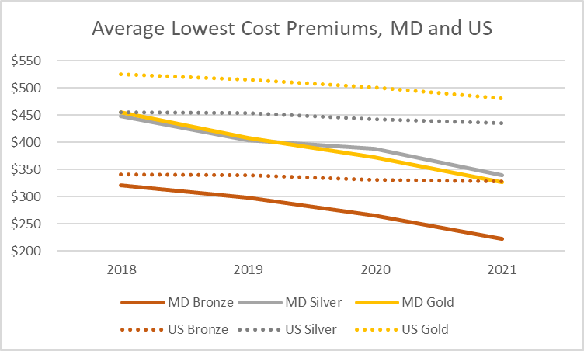
The Reinsurance Program Has Successfully Reduced Premiums
Monthly premiums are down an average of 11.9% for 2021, and more than 30% compared to 2018
In 2021, Maryland’s lowest cost plans will be about 20-30% below US averages, depending on metal level
Plan Year | Individual Premium Change
2014 | n/a
2015 | 10%
2016 | 18%
2017 | 21%
2018 | 50%*
2019 | -13%
2020 | -10%
2021 | -12%
Data from Kaiser Family Foundation, “Average Marketplace Premiums by Metal Tier, 2018-2020”, available at https://www.kff.org/health-reform/state-indicator/average-marketplace-premiums-by-metal-tier
*This reflects increases to on-exchange silver plan premiums to adjust for the fact that the federal government stopped making cost-sharing reduction payments. Absent this adjustment, the average premium change would have been 28%. The additional increase is largely born by higher APTCs from the federal government rather than paid directly by consumers.

Slide 22
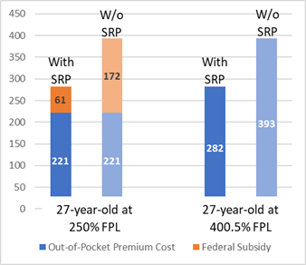
But Not Everyone Feels the Benefit of the Reinsurance Program
Comparison of 2021 Benchmark Plan Monthly Out-of-Pocket Premium Cost for 27-Year-Old in Baltimore City at 250% and 400.5% FPL, With and Without the Reinsurance Program
The benefits of the reinsurance program are primarily felt by households earning >300% FPL and particularly households earning >400% FPL (about $51,000 for an individual or $105,000 for a family of four), who earn too much to qualify for federal premium subsidies
Because of the way the federal subsidy structure works, reductions in premiums resulting from the reinsurance program are not typically felt by individuals at lower FPLs.
As a result, the reinsurance program is not an effective way to reduce premiums for individuals at lower FPLs, or to target subsidies towards specific populations such as young adults.

