Slide 1
Affordability and State Benchmark Plan Work Group Meeting
April 4, 2019

Slide 2
Affordability Work Group
Agenda
Welcome
Guest Speaker: Chris Koller, President of the Milbank Memorial Fund
Q & A
Guest Speaker: Allie Mangiaracino, Market Insights Analyst, Covered Califnornia
Q & A
Discussion
Adjournment

Slide 3
Chris Koller President of Milbank Memorial Fund

Slide 4
Using Policy Levers to Make Health Care More Affordable for Individuals and Employers
MD Health Benefits Exchange Workgroup
April 5, 2019
Christopher F. Koller

Slide 5
About the Milbank Memorial Fund
The Milbank Memorial Fund is an endowed operating foundation that works to improve the health of populations by connecting leaders and decision makers with the best available evidence and experience. Founded in 1905, the Fund engages in nonpartisan analysis, collaboration, and communication on significant issues in health policy. It does this work by publishing high-quality, evidence-based reports, books, and The Milbank Quarterly, a peer-reviewed journal of population health and health policy; convening state health policy decision makers on issues they identify as important to population health; and building communities of health policymakers to enhance their effectiveness.

Slide 6
Agenda
Principles
Assets in MD
Performance So Far in MD
Example from RI
Policy Levers in MD
Applications for MD

Slide 7
Principles (Systemic problems demand systemic solutions)
Focus on underlying costs - no cost shifting
Focus on per capita costs:
Price * utilization
(total costs = # of people * per capita cost)
We are more expensive than other countries because of higher provider prices and administrative costs - not higher utilization. Price is also driving trend rates.
The market will not work for health care services.

Slide 8
More Principles (Systemic problems demand systemic solutions)
Follow the money: seek public and private payer and regulatory alignment.
Act on evidence from elsewhere
Global budgeting
Primary care and prevention
Shared governance
Policy efforts –
Build on existing strengths; don’t chase the bright shiny object.
Think of your policy levers

Slide 9
MD Assets
Global Waiver – direction for delivery system reform agenda is set
Rate setting oversight capacity
State based exchange
Low uninsurance rate
Robust Insurer Market with local non profit as market share leader
Purple politics
Medicaid analytics shop (Hilltop)

Slide 10
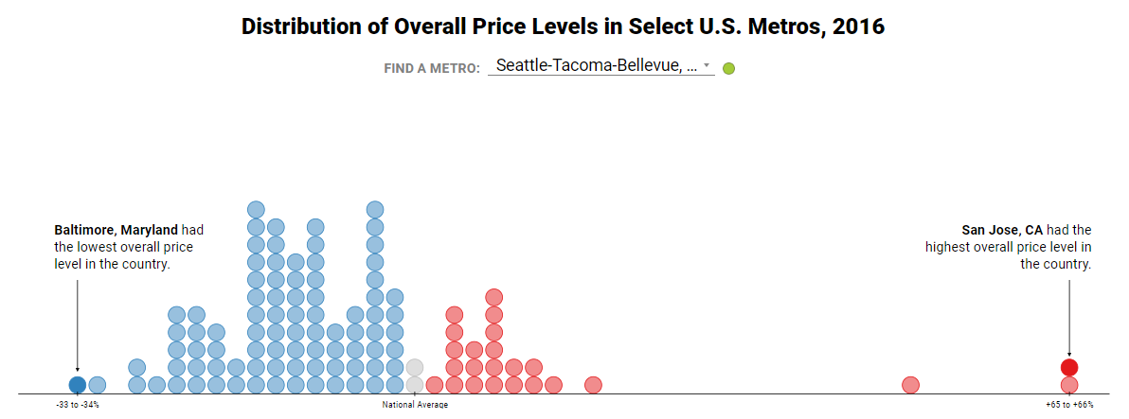
For Same Set of Services – Enormous Variation in Average Private Health Insurance Prices
Source: Health Care Cost Institute, 2016 data

Slide 11
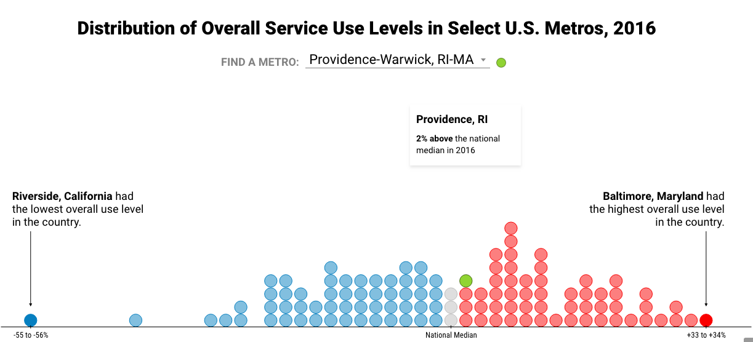
Variation in Utilization is Almost as Wide (and higher price areas tend to have lower utilization)
Source: Health Care Cost Institute, 2016 data

Slide 12
Total Commercial Costs: Some MD Utilization may be Risk Driven
Table 1: Total Cost Index and Resource Use Index Commercial Population 2016
 | Colorado | Maryland | Minnesota | Oregon | St. Louis, MO | Utah
Indexed Risk Score | 0.90-0.97 | 1.11-1.19 | 0.98-1.01 | 0.96-0.99 | 1.02-1.05 | 0.89-0.92
Rel. Use Index | 1.01-1.09 | 0.90-0.97 | 1.05-1.09 | 0.89-0.91 | 1.08-1.12 | 0.94-0.97
Price Index | 1.13 | 0.86 | 1.04 | 1.16 | 0.85 | 1.01
Total Cost Index | 1.15-1.23 | 0.78-0.83 | 1.10-1.13 | 1.03-1.06 | 0.92-0.95 | 0.95-0.97
Source: Network for Regional Health Care Improvement

Slide 13
Results for Maryland (Pre Global Budget)
 | Personal Health Care Spending (2014) |  |  | Average Annual Change, 2010-2014
 | Medicare | Medicaid | PHI | Medicare | Medicaid | PHI
United States | $ 10,986 | $ 6,815 | $ 4,551 | 1.2% | 0.0% | 3.3%
Delaware | $ 11,460 | $ 6,921 | $ 4,806 | 2.0% | 1.1% | 2.7%
Dis. of Col. | $ 11,814 | $ 8,998 | $ 8,831 | 1.0% | -3.4% | 2.8%
Maryland | $ 12,000 | $ 7,677 | $ 4,343 | 1.1% | -1.9% | 2.4%
New Jersey | $ 12,614 | $ 8,049 | $ 5,081 | 1.2% | -5.4% | 5.2%
New York | $ 12,179 | $ 9,803 | $ 5,338 | 1.0% | -1.5% | 3.3%
Pennsylvania | $ 11,243 | $ 9,407 | $ 4,634 | 1.2% | 3.2% | 4.2%
Source: Cuckler et al. Health Spending By State 1991-2014: Measuring Per Capital Spending By Payers and Programs,Health Affairs, June 2017

Slide 14
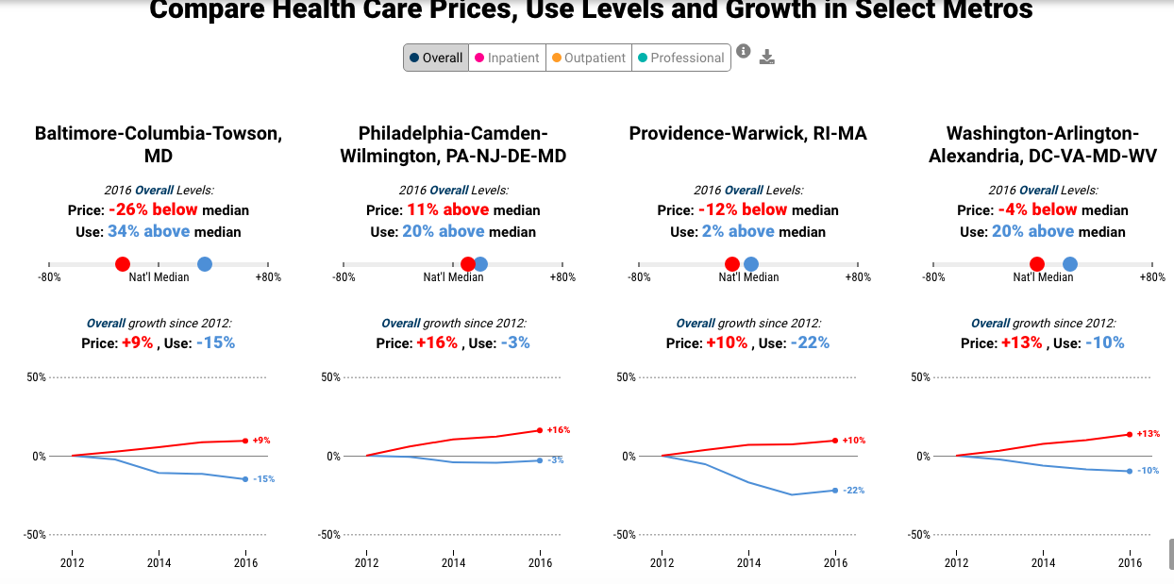
Price and Use Combined – Baltimore Stacks Up Relatively Well

Slide 15
Opportunity for Maryland
Build on strong base
With global waiver established, spread delivery system reform efforts to more dispersed, harder to coordinate outpatient settings.
Offer alternative to provider consolidation

Slide 16
2003: In response to Physician and Employer Outcry Over Insurer Behavior, RI Legislature Strengthens Health Insurer Oversight
New Charge
- See the system as a whole and direct insurers to policies that promote affordability, accessibility and quality of system

Slide 17
Full Rate Review and Comprehensive Set of Affordability Standards for RI Insurers
Invest in Primary Care (Raise Primary Care Spend by One Point a Year for Five years)
Not in FFS increases, not add on to overall costs
Support Multipayer Efforts
Invest in Health Information Technology
Implement Value Based Payment Model with Caps on Hospital Rate Increases
Developed with Advisory Council.
Enforced through rate review process

Slide 18
Make the Slice Bigger
“This evidence shows that primary care helps prevent illness and death, regardless of whether the care is characterized by supply of primary care physicians, a relationship with a source of primary care, or the receipt of important features of primary care. The evidence also shows that primary care (in contrast to specialty care) is associated with a more equitable distribution of health in populations, a finding that holds in both cross-national and within-national studies”.
Source: (Starfield Milbank Q. 2005 Sep; 83(3): 457–502.)
Primary Care (estimated commercial)
Source: CMS Actuary. All Payments

Slide 19
Why Primary Care Spend as a Goal?
Supported by evidence
Number and implications easily comprehended by public
Non-partisan
ACO/VBP evidence is that primary care governed entities succeed and acute care-governed ones do not.
Communicates misplaced social priorities and builds consensus on societally-oriented goals:
“Gateway” policy to more attention to social services investing

Slide 20
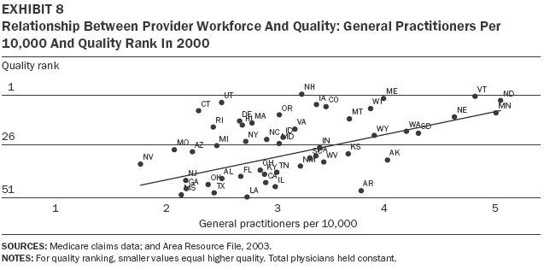
What is the Evidence? Primary Care Associated with Higher Quality…
Source: Baicker & Chandra, Health Affairs, April 7, 2004

Slide 21
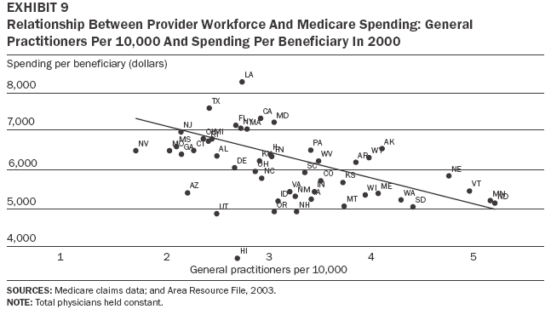
…And Lower Costs
Source: Baicker & Chandra, Health Affairs, April 7, 2004

Slide 22
Making Primary Care a Priority for the State’s Health Care System: A little gets you a lot.
Primary Care Spending as Percent of Total Medical Spending Insurer (2008-2017)
Increasing Primary Care Spend is high leverage:
In RI, primary care spending by commercial insurers increased from $47 million/year to $73/year over this period. Self insured not captured
Source: Office of the Health Insurance Commissioner, State of Rhode Island

Slide 23
Hospital Rate Trend Caps and VBP implementation timeline
Origin – Insurer rate review documented large price increases to hospitals from plans
Insurance Commissioner study documented wide variations in average prices paid to hospitals as percent of Medicare.
Hospitals unwilling to adopt VBP voluntarily.
Agreed to by plans as a signed condition to annual rate increases. They impose in contracts. Regulator audits contracts.
Supported by Advisory Council.
In Regulation. Withstood court challenge

Slide 24
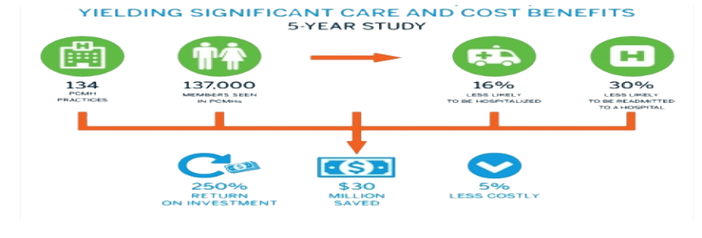
What Happened in RI?
Top Ten Medicare ACO
Health Information Exchange
Successful PCMH at Blue Cross
Multi-payer Primary Care Transformation

Slide 25
RI Defied Trends and Increased Primary Care Supply (No Specialty Flight)
Notes: MDs only; Primary Care: FP, Peds, IM;
Sources: AMA Licensure and Census.Gov

Slide 26
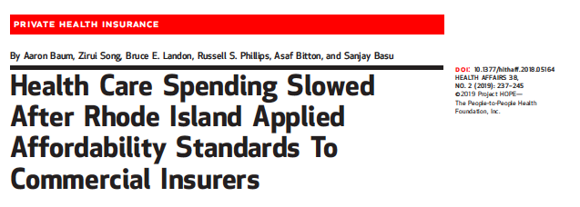
Have a Delivery System Transformation Plan - Engage Commercial Payers
Goal:
Study effects of Affordability Standards
RI Claims vs similar population
Matched for demographics and enrollment.
Look at Differences in Differences

Slide 27
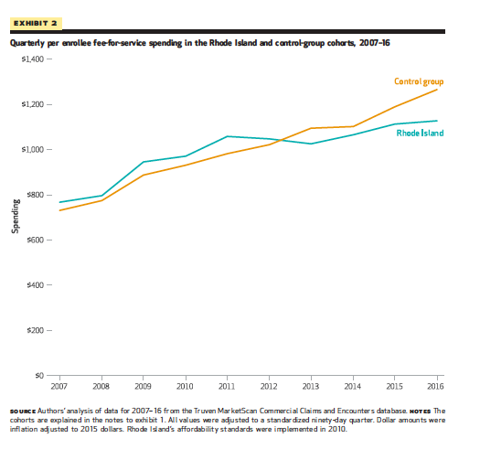
Headline: RI Bent the Trend
Researchers found no lessening of quality.
“Our analysis suggests that price inflation caps and diagnosis-based payments, which led to lower prices, drove a broad and sustained reduction in commercially insured health care spending growth. Furthermore, combining price control measures with a requirement to markedly increase funding to primary care practices led to a redistribution of spending toward primary care without net losses to payers.”
Source: Baum et al

Slide 28
2. Oregon – Comprehensive Primary Care
Led by Oregon health Authority
Primary Care Transformation Collaborative
Primary Care Spend Legislation
Multi payer collaborative (Medicare CPC+)
Source: https://www.oregon.gov/oha/HPA/dsi-pcpch/Documents/SB-231-Report-2018-FINAL.PDF

Slide 29
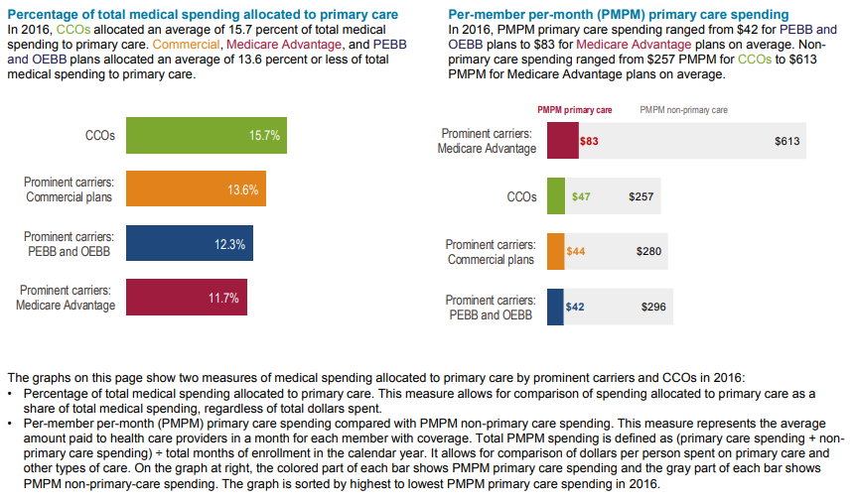
Goal-Baseline and Document Variation by Product Line

Slide 30
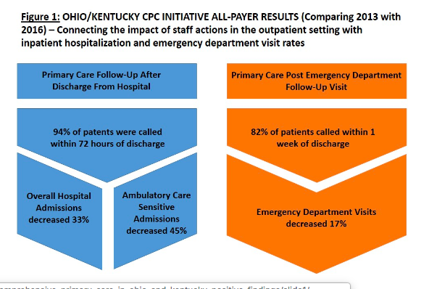
All Payer Primary Care Can Get You A Lot

Slide 31
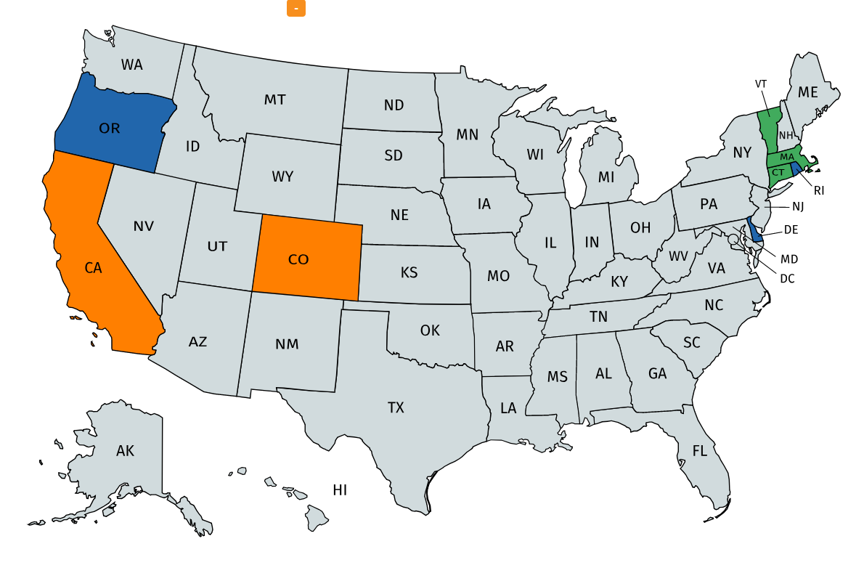
Primary Care Spend Idea is spreading –
Statutory or Regulatory Action
Proposed Legislation
State-wide Measure of Primary Care Spend

Slide 32
What are your policy levers?
Global waiver
Medicaid
payments and coverage
Health plan contracts
Supplemental payments
Commercial
Rate Review
Benefits enforcement
Examination statute
Exchange
Plan design
Rate approval - coordination with DOI
Conditions for participation on Exchange

Slide 33
What are your policy levers (cont’d)?
Public Employees
Benefits. Payments, TPA conditions
Provider Licensing
Data
Reporting and Measurement
More?

Slide 34
What could MD do with an aligned focus on high quality Comprehensive Primary Care?
Public Oversight Group – (Not new, not provider or payer driven) CF Oregon
Single standard for high quality comprehensive primary care
Multipayer table
Technical Assistance for Xformation
CRISP, APCD’s
Measure penetration
Pay more for it
Finance with PCP spend requirement
DOI, Medicaid and Public Ees
Workforce development
Public Reporting – Plans, PCP’s, Accountable Care Entities, State
Benefit Plan Design
Public Ees and Exchange

Slide 35
The Goal: Policy Alignment
Alignment = Power

Slide 36
Question and Answer Session

Slide 37
Questions
What metrics would you recommend we use when we are considering benefits that will result in maximum improvements to health outcomes?
How do you think quality adjusted life years fit into the picture?
Are there other types of metrics we should consider?

Slide 38
Allie Mangiaracino Sr. Market Insights Analyst Analytics & Informatics Unit Plan Management Division Covered California

Slide 39
CALIFORNIA’S STANDARD BENEFIT PLAN DESIGNS
MARYLAND HEALTH BENEFIT EXCHANGE – AFFORDABILITY WORKGROUP
Allison Mangiaracino, MPH
Sr. Market Insights Analyst, Covered California
April 5, 2019

Slide 40
OBJECTIVES
Philosophy of standardized benefits
Covered California’s experience (annual process for setting cost-sharing, guiding principles, etc.)
Consumer and market impact of standardized benefits

Slide 41
WHAT IS COVERED CALIFORNIA?
State-run marketplace where eligible Californians can compare and shop for health insurance plans and receive federally-funded financial assistance to help pay for healthcare premiums
Independent public entity within state government with a five-member board appointed by the Governor and the Legislature

Slide 42
2019 QUALIFIED HEALTH PLAN (QHP) ISSUERS

Slide 43
COVERED CALIFORNIA BENEFIT DESIGNS
Qualified Health Plan (QHP) issuers are required to offer products using Covered California’s Board-approved Standard Benefit Plan Designs (SBPDs) per the QHP Contract.
California law¹ authorizes the Covered California Board to standardize products offered through the Exchange.
Issuers must offer all four metal levels of coverage using the standard plan designs and offer “mirrored” products using these benefit designs off the Exchange.
Plan-proposed alternative benefit designs are accepted in Covered California for Small Business (CCSB), which serves employers with up to 100 employees (California expanded the definition of Small Group to include employers with 100 or fewer employees)
The SBPD is adjusted annually to meet AV requirements, clarify benefit administration, and incorporate benefit design innovations.
¹California Government Code 100504(c)(1).

Slide 44
PHILOSOPHY OF STANDARD BENEFITS
Behavioral Economics and Consumer Decision-Making
In high-stakes decision-making, too many options can discourage action or lead to sub-optimal choices.
Health insurance jargon and cost-sharing concepts are confusing (coinsurance, copays, deductibles, etc.).
Understanding how these features interact, and weighing them against other plan features like monthly premiums, provider networks, and quality, is challenging for the average consumer.
Market Stability
Increased choices in an insurance market can create more opportunity for adverse selection, either directly or indirectly.²
²Adverse Selection Issues and Health Insurance Exchanges Under the Affordable Care Act, National Association of Insurance Commissioners (2011), p. 5, available at http://www.naic.org/store/free/ASE-OP.pdf

Slide 45
PHILOSOPHY OF STANDARD BENEFITS (CONT.)
Covered California opted to require standard benefit plan designs to:
Enhance consumers’ ability to compare plans and make decisions, resulting in higher satisfaction and less anxiety
Provide an apples-to-applies comparison of plan products, allowing consumer choice to be based on price (premiums), networks, and quality
Ensure consumer affordability and access to care are considered in all plan products offered on the individual market via a transparent policymaking process
Avoid adverse selection stemming from benefit design differences between issuers (i.e. using benefits to attract or deter consumers based on risk)

Slide 46
ANNUAL PROCESS FOR STANDARDIZING BENEFITS
The Plan Management Division (PMD) leads an annual benefit design workgroup to determine consumer cost-sharing and benefit design policies for the following plan year.
Members and attendees from the Plan Management Advisory Group Committee, which meets monthly to discuss policy and program issues, participate in the benefits workgroup.
Workgroup membership includes representatives from health and dental plans, consumer advocacy groups, and state regulators
The workgroup meets for 5-6 meetings starting in the fall (when the draft Notice of Benefit and Payment Parameters and AV Calculator are released).
The workgroup and the broader Plan Management Advisory Group Committee advise PMD on benefit design changes before the plan designs go to the Board for approval in March.

Slide 47
STRATEGY FOR STANDARD BENEFIT PLAN DESIGNS
Organizational Goal
Covered California should have benefit designs that are standardized, promote access to care, and are easy for consumers to understand = PATIENT-CENTERED.
Principles
Multi-year progressive strategy with consideration for market dynamics: changes in benefits should be considered annually based on consumer experience related to access and cost
Adhere to principles of value-based insurance design by considering value and cost of clinical services
Set fixed copays as much as possible and utilize coinsurance for services with wide price variation to encourage members to shop for services
Apply a stair-step approach for setting member cost shares for a service across each metal level, e.g. in 2019, a primary care visit is $40 in the Silver tier, $30 in Gold, $15 in Platinum
TRIPLE AIM
Improve health of populations
Reduce costs of health care
Improve consumer experience of care

Slide 48
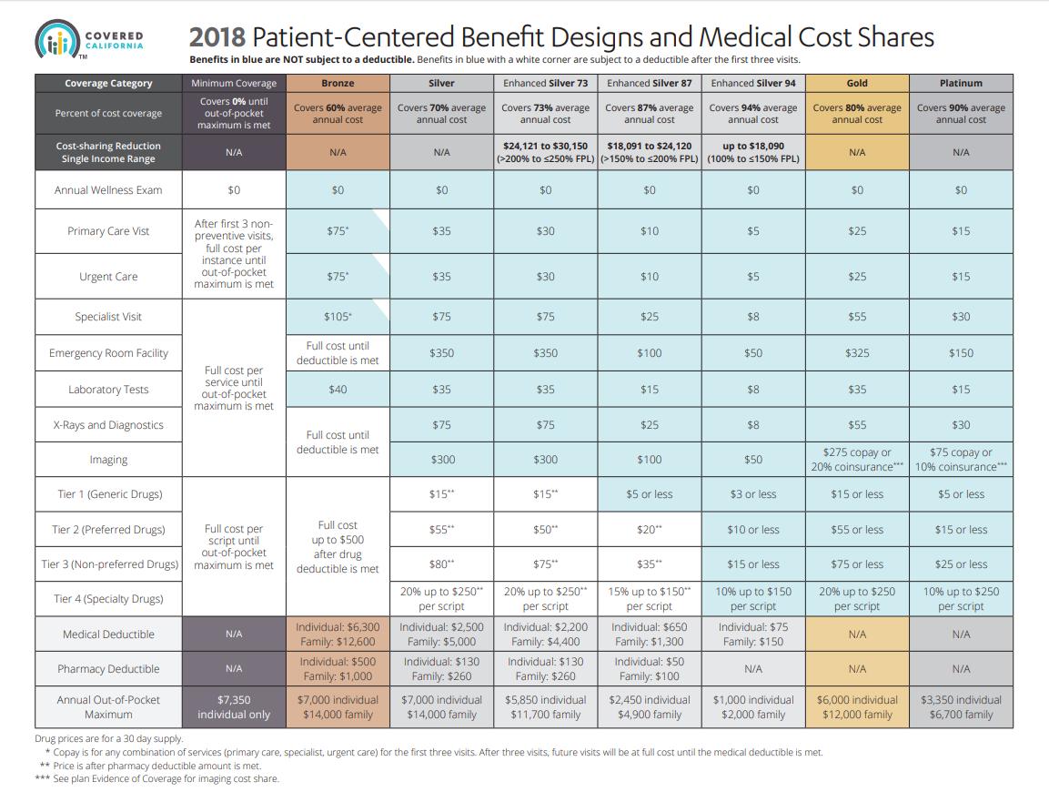

Slide 49
IMPACT OF STANDARDIZED BENEFITS
Market Impact of SBPDs
Streamlines evaluation of health plan bids (i.e. simplifies review of complex rate filings and provides clarity of what drives premium differences).
Potentially contribute to a better risk mix, i.e. patient-centered designs do not have high deductibles on most services and thus deductibles are rarely an impediment to getting needed routine care.
Potential driver of enrollment (easier for consumers to understand products)

Slide 50
IMPACT OF STANDARDIZED BENEFITS (CONT.)
Consumer Impact of SBPDs
Lower exposure to deductibles and other cost-sharing compared to consumers in other states³
Consumers choosing the right plan for their health needs (risk scores are higher for individuals enrolled in plans with higher actuarial value)⁴
Improved customer satisfaction⁵
Consumers in all plan tiers see value by having the opportunity to get some services (e.g., PCP services) without high deductibles
³Covered California, “Delivering on the Promise of the Affordable Care Act,” https://nashp.org/wp-content/uploads/2015/07/7-17-15-CoveredCA-Delivering-on-the-Promise-of-the-ACA.pdf
⁴Covered California, “Covered California Continues to Attract Sufficient Enrollment and a Good Risk Mix Necessary for Marketplace Sustainability,” https://hbex.coveredca.com/data-research/library/CoveredCA_Sufficient_Enrollment_Good_Risk_Mix.pdf
⁵Covered California, “New Data Show How Covered California Spurs Competition Among Health Insurance Companies,” https://www.coveredca.com/newsroom/news-releases/2016/02/17/New-Data-Show-How-Covered-California-Spurs-Competition-Among-Health-Insurance-Companies/

Slide 51
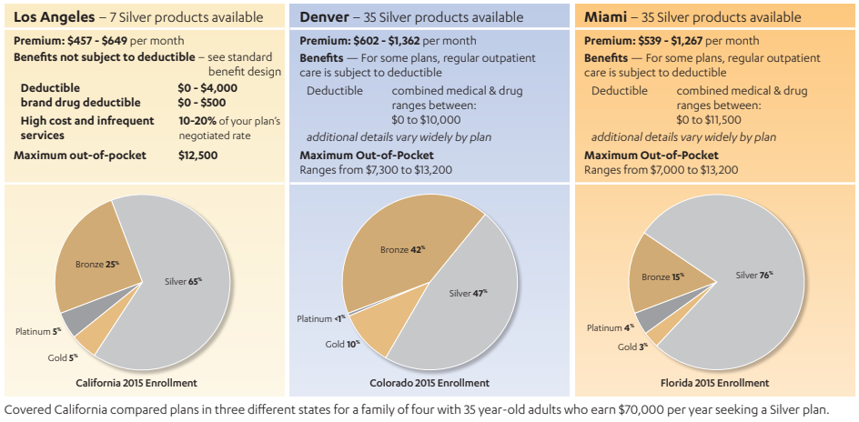
IMPACT OF STANDARDIZED BENEFITS (CONT.)
A Tale of Three Cities

Slide 52
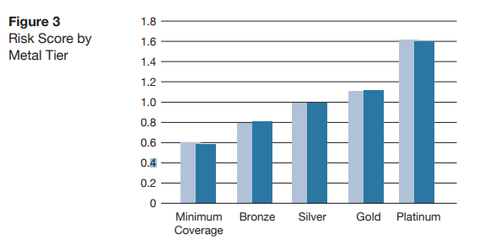
IMPACT OF STANDARDIZED BENEFITS (CONT.)
For both the 2016 and 2017 enrollment cohorts, Figure 3 shows that mean risk scores increased as plan actuarial value increased.
Consumers are selecting a plan metal tier that provides financial coverage for their expected health care needs.
In 2017, mean risk score by metal tier is lowest (0.58) for those enrolled in minimum coverage plans (“catastrophic” plans) and highest (1.60) for those enrolled in Platinum plans.
For full report, see “Covered California Continues to Attract Sufficient Enrollment and a Good Risk Mix Necessary for Marketplace Sustainability,” https://hbex.coveredca.com/data-research/library/CoveredCA_Sufficient_Enrollment_Good_Risk_Mix.pdf

Slide 53
REFERENCES/FURTHER READING
Covered California issue paper, “Key Ingredients to Creating a Viable Individual Market That Works for Consumers: Lessons from California”: See page 6 for information on the standard benefit designs. https://hbex.coveredca.com/data-research/library/CoveredCA_Key_Ingredients-05-18-17.pdf
Consumers Union report, “Healthcare By Design: Consumer-Centric Benefits for California’s Individual Market”: https://advocacy.consumerreports.org/wp-content/uploads/2017/07/Healthcare-By-Design-July-2017.pdf
Board presentation, 2019 Standard Benefit Plan Designs: https://board.coveredca.com/meetings/2018/01-18/PPT%20-%20Board_Policy_and_Action-Jan_2018-final.pdf
2019 Standard Benefit Plan Designs: https://hbex.coveredca.com/stakeholders/plan-management/PDFs/FINAL-2019-Patient-Centered-Benefit-Plan-Designs-2018-03-15-Clean.pdf

Slide 54
Question and Answer Session

Slide 55
Questions
Please speak about how Covered California implemented a "focus on health disparities" to provide the right care and bring down costs.

Slide 56
Discussion

